Slide 1
PYTHON PROGRAMMING
MODULE 2

Slide 2
Variables
Pre-requisted for this part:
Algebra
Unknown variable

Slide 3
Did you know how to solve this?
x + 5 = 10

Slide 4
Types of Variables
Integer
Whole number
Float
Decimal Number
Char
Characters
e.g= 5
e.g= 1.5
e.g= ‘a’,’b’,’c’
Strings
Words
e.g= “Hello”

Slide 5

Variables in Python
Now, let us see how to write variables in python.
First, define the variable.
E.g:

Slide 6
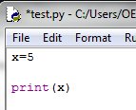
Print variables
Write like this

Slide 7
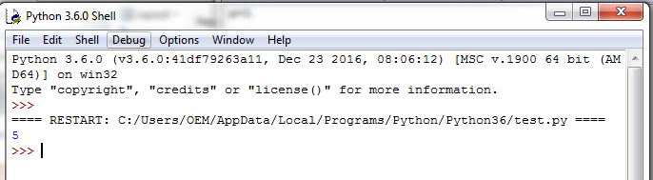
The output

Slide 8
Exercise
Write your own variables. Then print them.
E.g=
Y= 5
X= 7
Number = 3

Slide 9
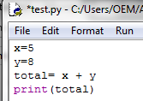
Mathematical Operations
After learning about variables, let us learn how to calculate in python
Write these codes:

Slide 10
Strings Variable
We also can define strings variable.
Such as these examples:
first_name = “Sarah”
last_name= “Ali”

Slide 11
Strings Operation
We can also combine strings by adding them.
E.g:
full_name = first_name + last_name

Slide 12
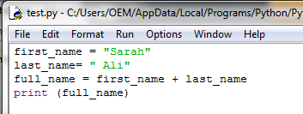
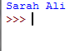
Example
Input:
Output:

Slide 13
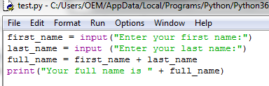
Getting strings input from user
Now, let us see how to get user input
To get user input, simply define the variables with this format:
variable_name = input (“Prompt message”)
e.g:

Slide 14
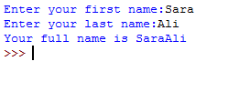
Outputs
input

Slide 15
Exercise
Write a code that ask your friend’s name

Slide 16

Getting integer input from user
Now, let us learn how to get numbers or integer from user.
To get user input, simply define the variables with this format:
number= int(input (“Prompt message”))
e.g:

Slide 17
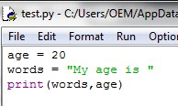
Print combination of variables
To print different type of variable, follow the following format:
print( integer , strings)
e.g:

Slide 18
Exercise
Write code that ask user’s age
Print a word like this:
“Your age is ________”

